Slide 1
Software Engineering Project Wandering in the Woods

Slide 2
Introduction
In this project we have explained the case study requirement and the documented the result in the written format. After using the agile methodology and if needed then it is subject to change the requirement. In the fist part of this project we have defined that model of the system architecture. In this part we evaluated what is actually determined for this project. Here we have present the final blueprint of the project.

Slide 3
Purpose: Wandering in Woods
Wandering in the Woods, game is a simplistic visual to explain the core notion for the children of the elementary school.
After gaining the data we can evaluate data, make decisions, and tackle previous and upcoming problem related to this project.
In the next grade the student can be able to make more advance vision of work in the next part of the project.

Slide 4
Model of the project
The process of this project allow us to understand the internal business process and also utilize the knowledge in the better management of the problem.
In the agile manner continuous improvement can be define for the organizational purpose which can be able to manage product development model.
This ideas can also be used in the software development process.
This approach of the process spare the project into some of the manageable pieces and help them normalize into the deliverable stages.

Slide 5
Graphical presentation
Initial Version
Specification
Rough Requirement
Development
Intermediate Version
Validation
Final Version

Slide 6
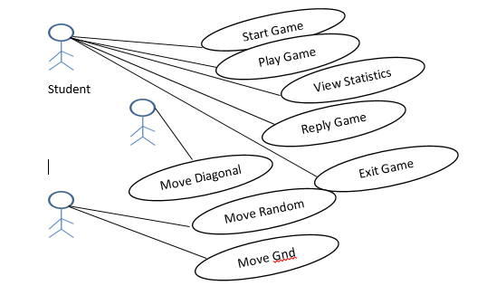
Use case diagram

Slide 7
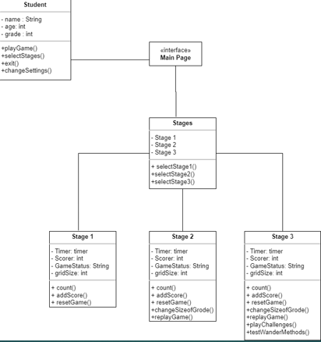
Class Diagram

Slide 8

Deployment Diagram
BROWSER
HTTPS
Web Server
Apache
Database connectivity
Application server
Database Server
Servlet Application
SQL

Slide 9
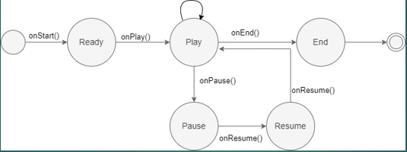
State Diagram

Slide 10
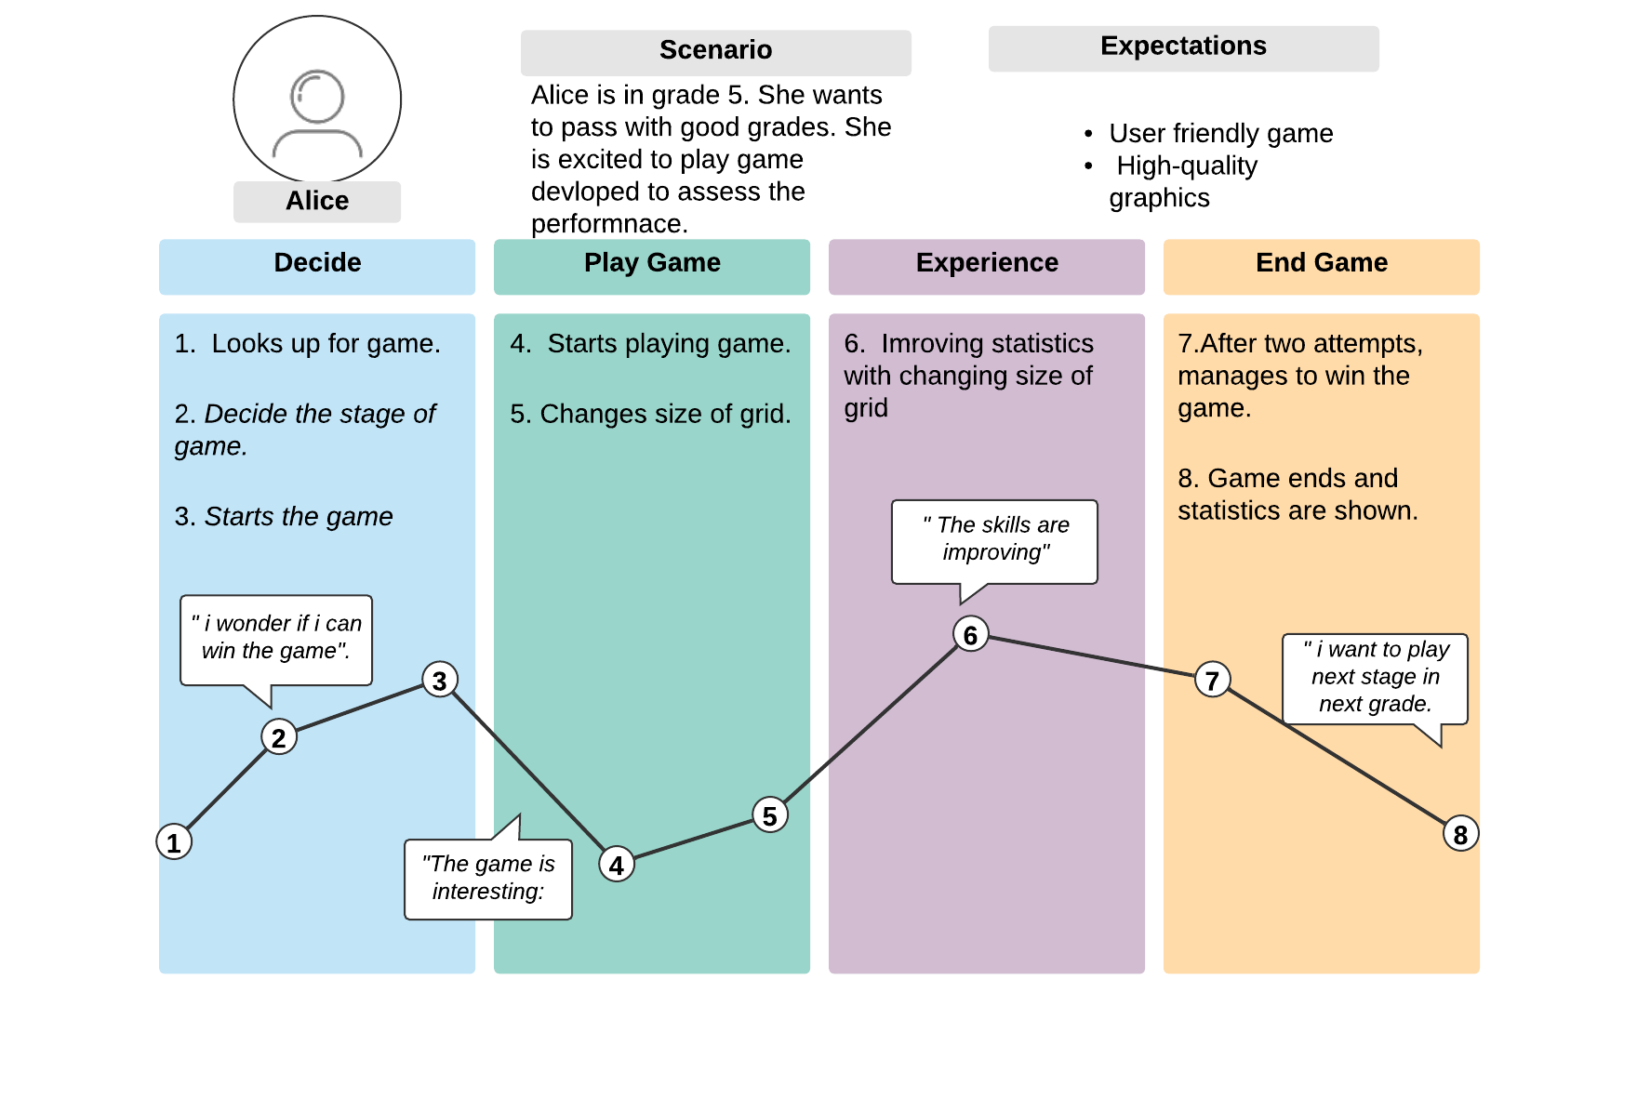
Customer Journey map

Slide 11
Conclusion
User personas are archetypes of customers that designers and builders can use to empathize with them. Creating personas will let you step out of yourself. In addition to helping, you apprehend and discover with the desires and expectancies of various customers, designing for them will let you understand their differences. After reading the system, the designers have recognized a user, who's scholar of eight grade and is susceptible in a few subjects. He is keen on gambling games. So, this sport will assist him a lot. But he may also face a few new demanding situations in sport, so suggestions ought to additionally be provided, and interface ought to be smooth to navigate

